Slide 1

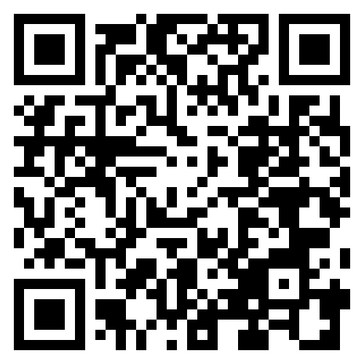

NEW WEBSITE
Your practice is part of the North Connect Primary Care Network of practices.
The network has launched a new website to provide more information for patients to help keep you healthy and well.
You can access the website by scanning the code to the right with your smartphone camera (while connected to the internet) or visit: https://www.northconnectpcn.nhs.uk/ on your smartphone or desktop computer.
Acre Surgery Acrefield Surgery Carepoint Practice Devonshire Lodge Practice
Northwood Health Centre South Ruislip Northwood Health Centre Eastcote
Eastbury Surgery Harefield Practice Mountwood Surgery
Northwood Harefield Northwood

Slide 2

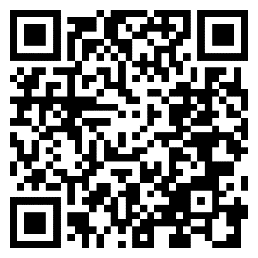
Find more information online with our new website
Scan this code with your smartphone camera
www.northconnectpcn.nhs.uk
Notes:
© Copyright PresentationGo.com – The free PowerPoint template library

Slide 3


New website for
Your Primary
Care Network
You can access the website by scanning the code in the top corner with your smartphone camera or visit: https://www.northconnectpcn.nhs.uk/ on your smartphone or desktop computer.
Notes:
© Copyright PresentationGO.com – The free PowerPoint and Google Slides template library

